Slide 1
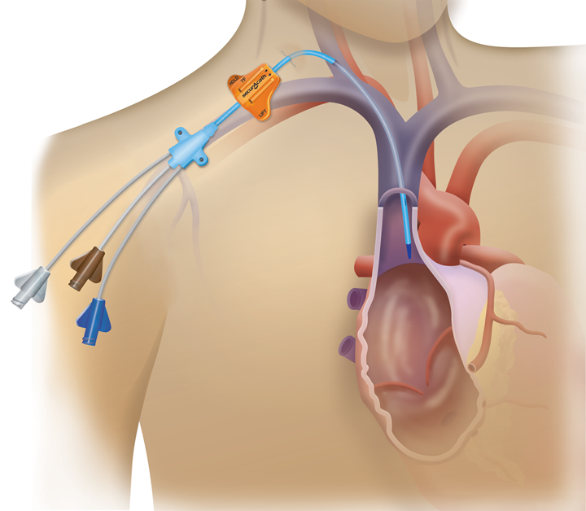
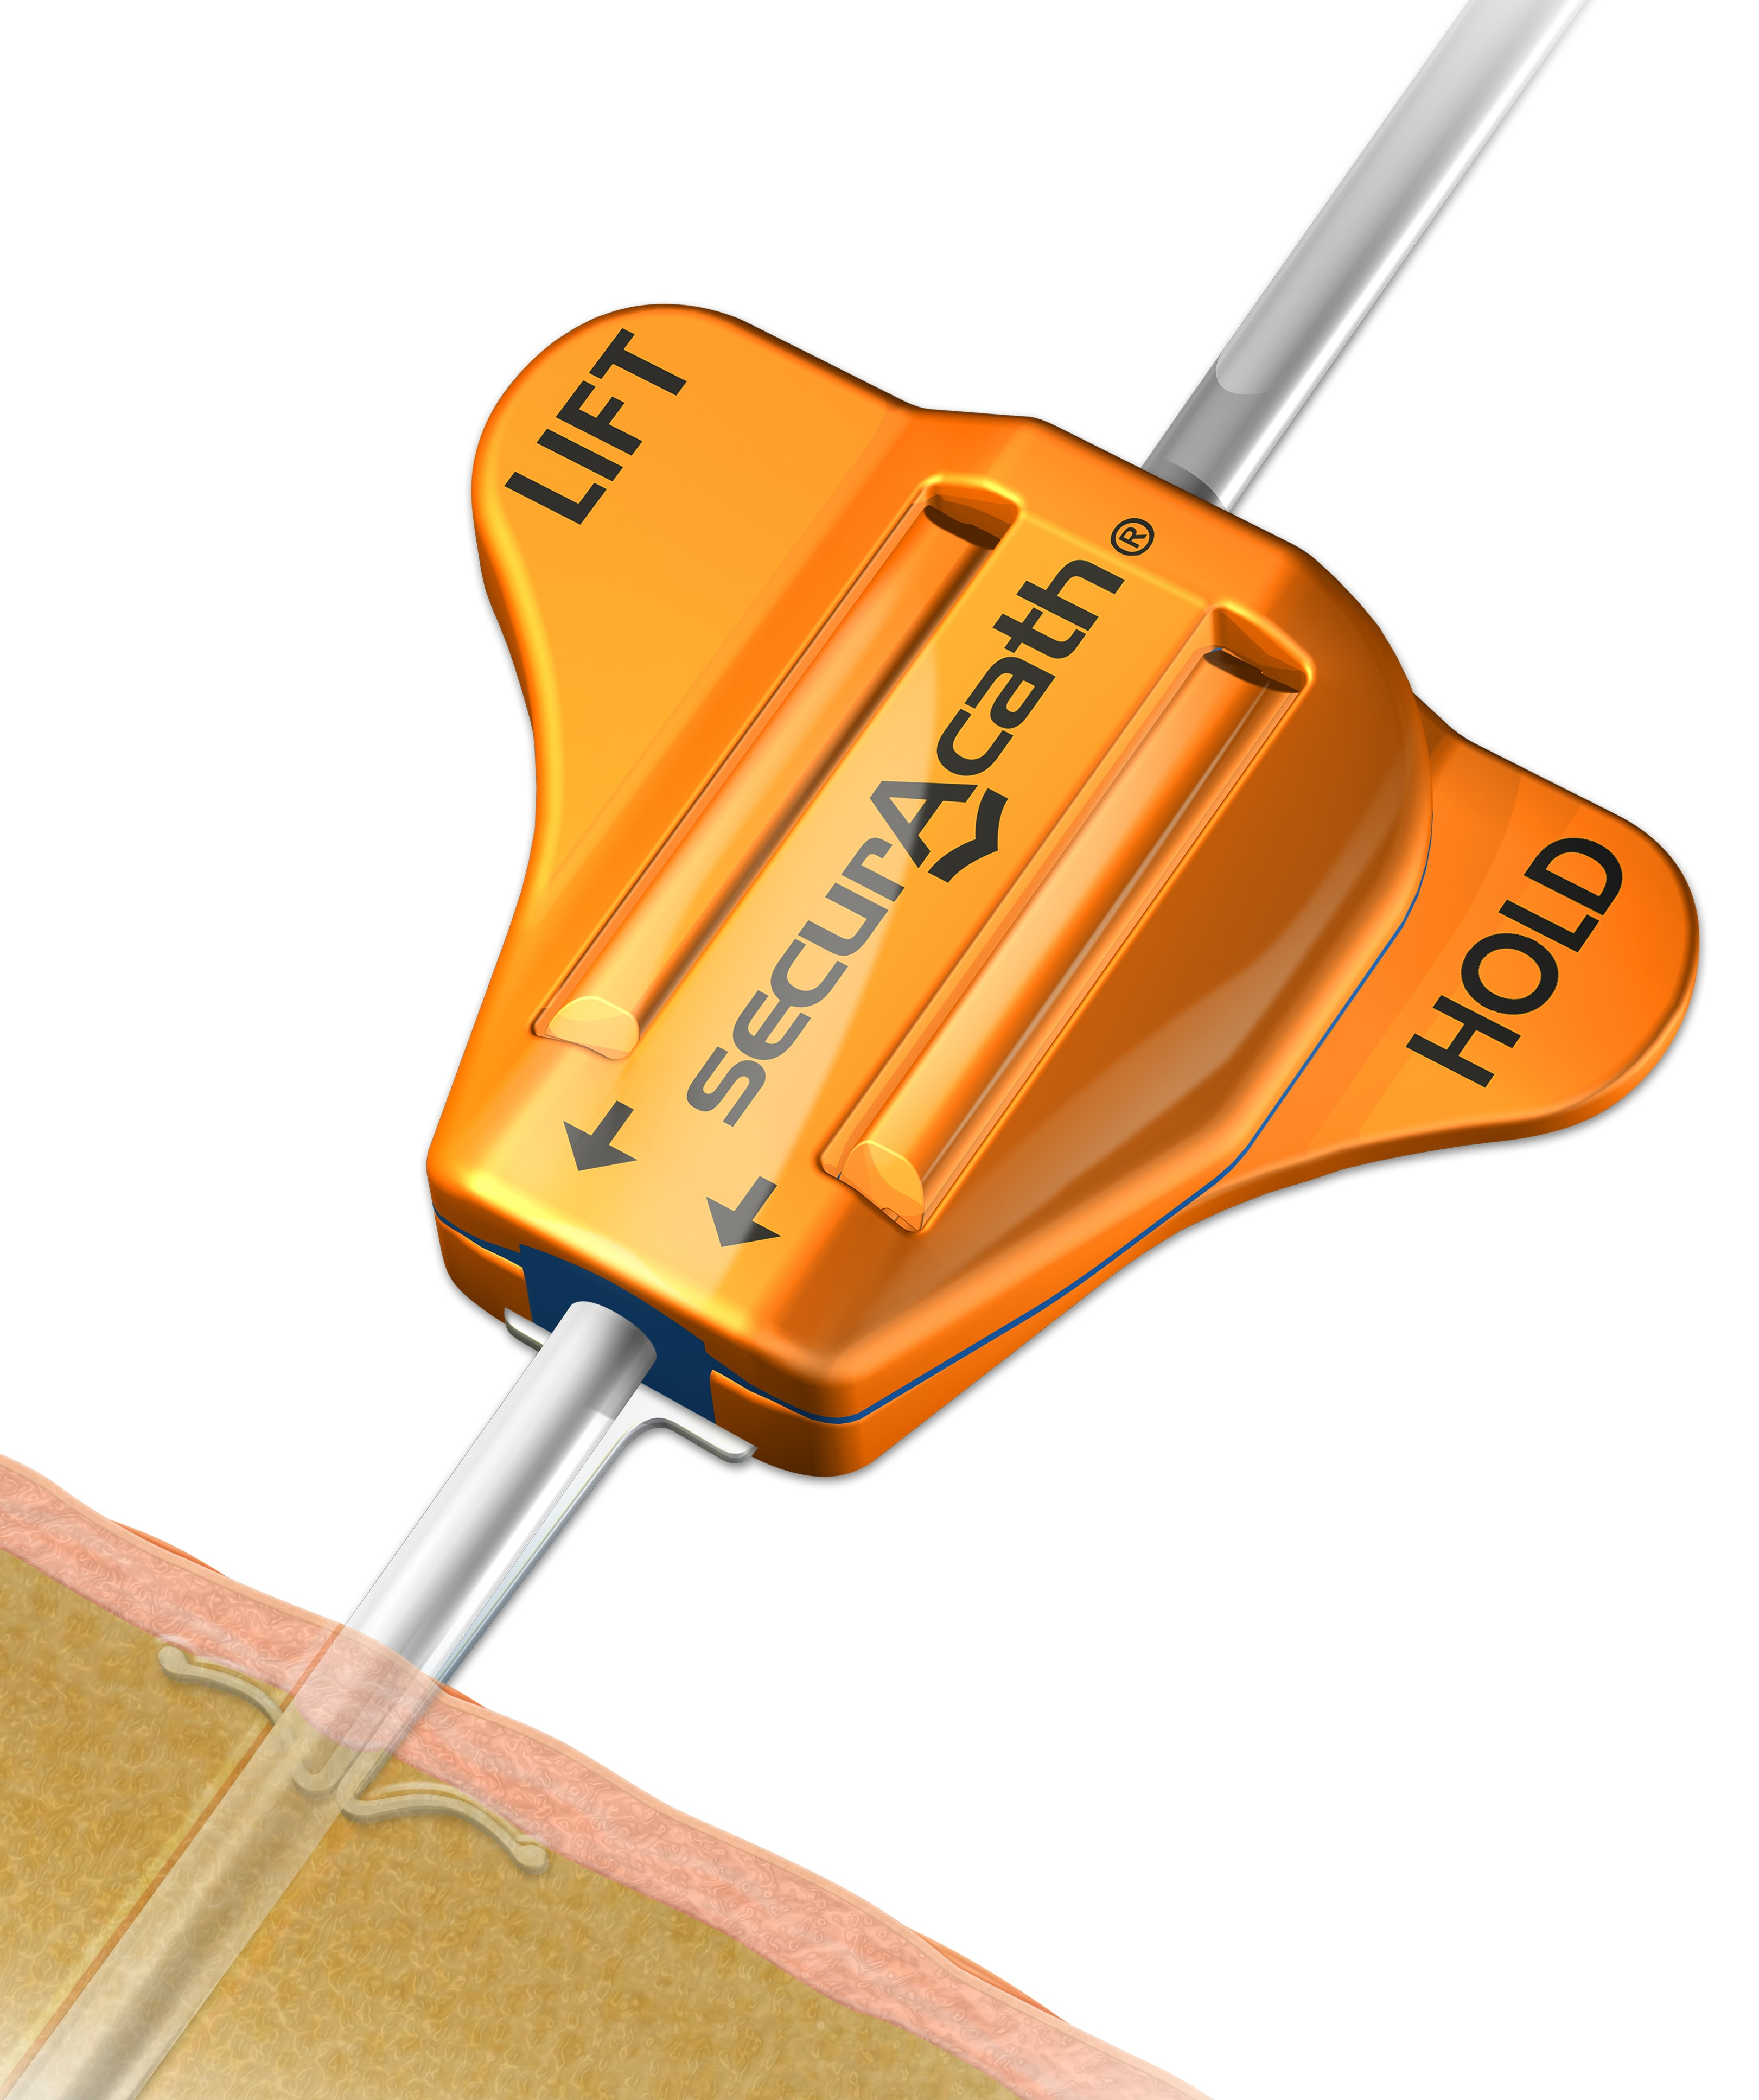
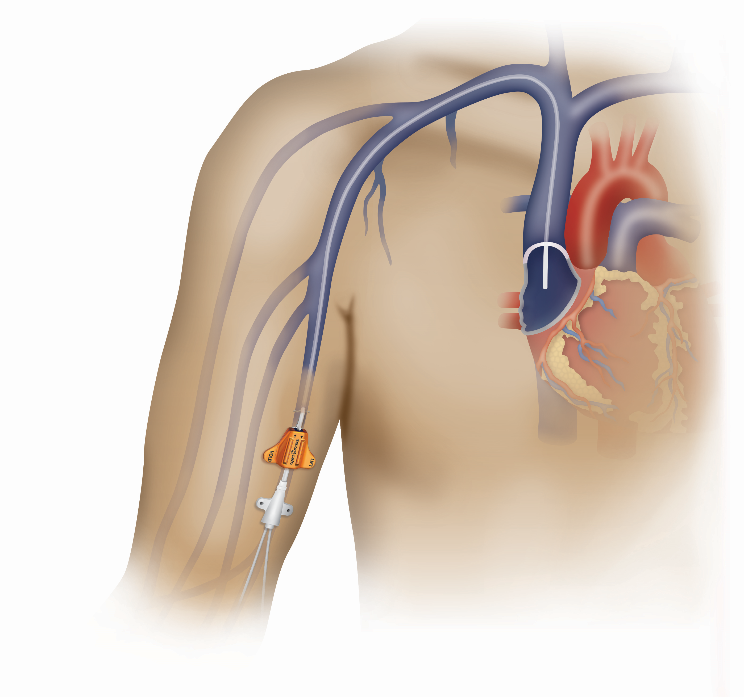
Applications
External Ventricular Drainage
8-12F
Central Line
7-10F
General Drainage
8-12F
PICC
3-6F

